Slide 1

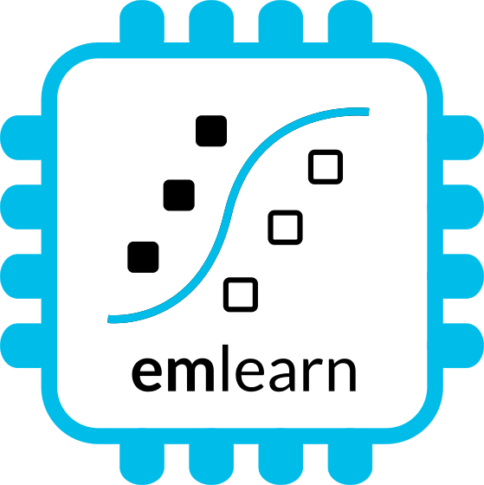
Sensor data processing on microcontrollers
with MicroPython and emlearn https://github.com/emlearn/emlearn-micropython
Jon Nordby jononor@gmail.com
PyCon ZA 2024
Notes:
Hi everyone. Glad to see so many being curious about microcontrollers! I have with be a munch of MicroPython compatible devices today. So if anyone is interested in borrowing for trying it out, we can do that after the session. On the A floor, next to the tutorial rooms. And one lucky person that asks a question will get one of these devices to take home!

Slide 2
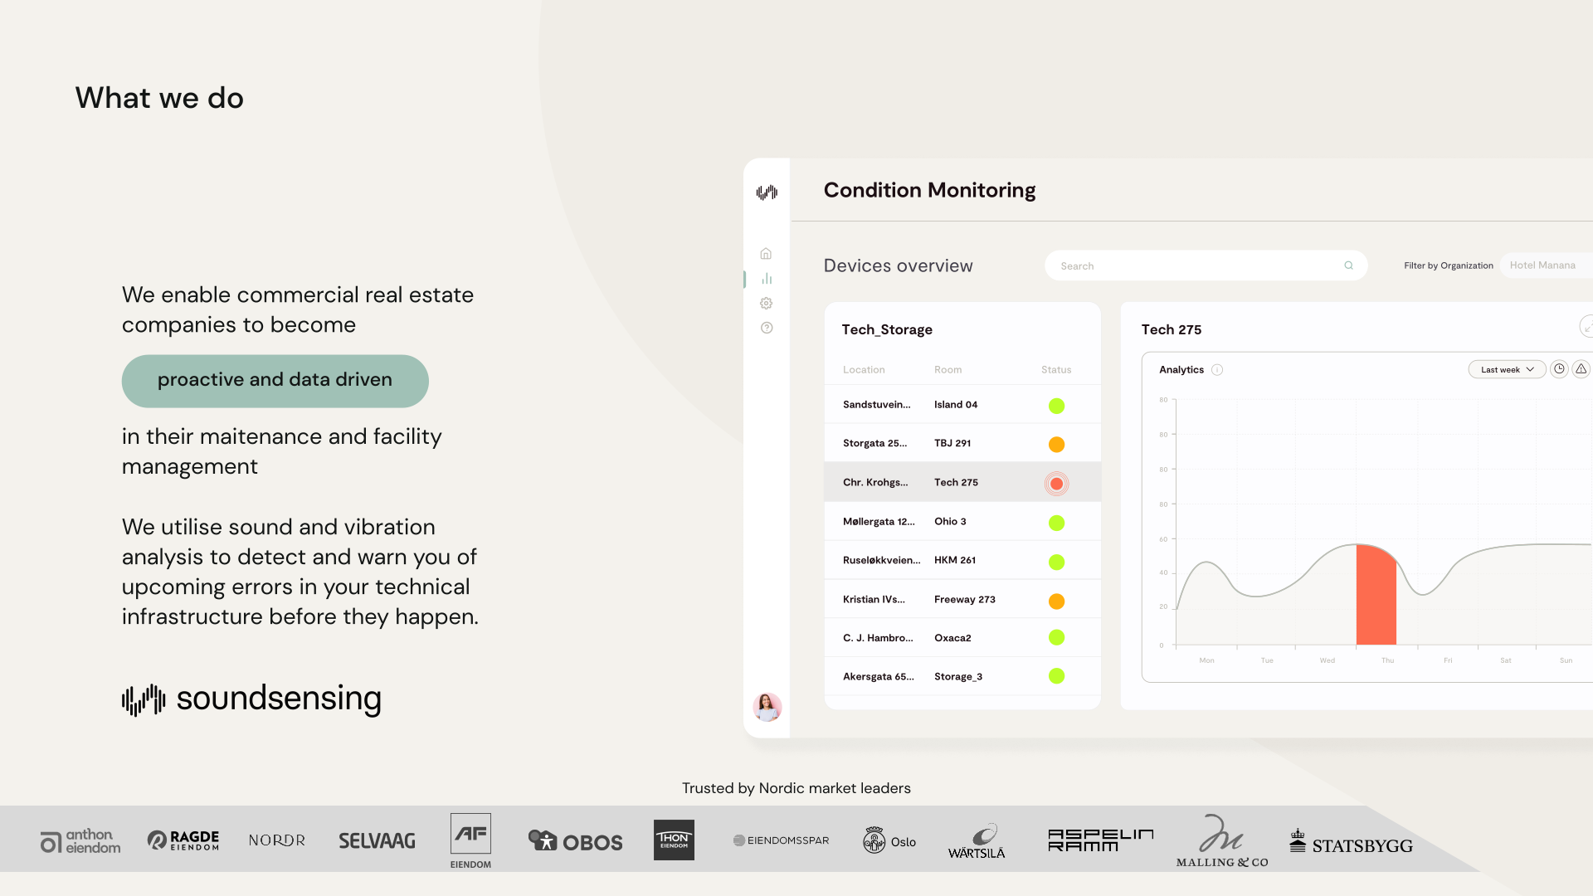
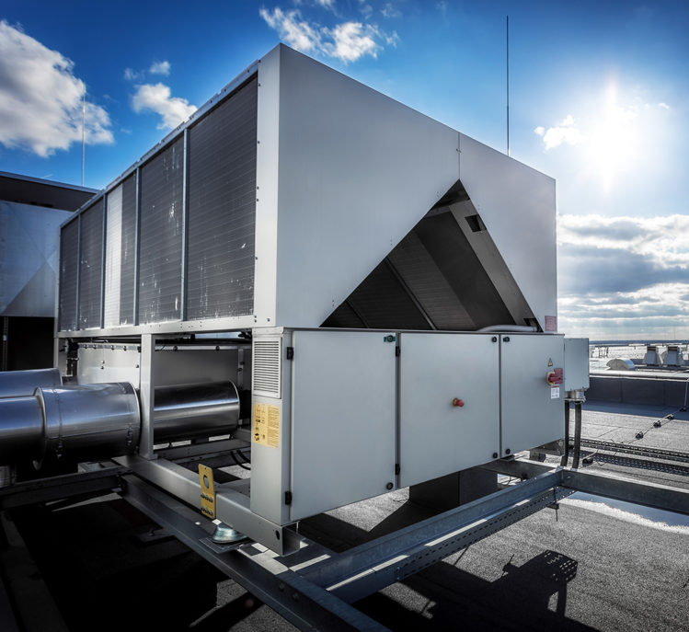
Notes:
Work as Head of Data Science at Soundsensing.
Soundsensing is a leading provider of predictive maintenance solutions for ventilation systems in buildings. So we work a lot with sensor data. And also use Python as much as we can for Data Science, IoT and backend tasks.

Slide 3
Goal
You, as a Python developer, can build an IoT sensor
on a microcontroller
using MicroPython
Purpose of this presentation
Notes:
The goal of the presentation today is …

Slide 4
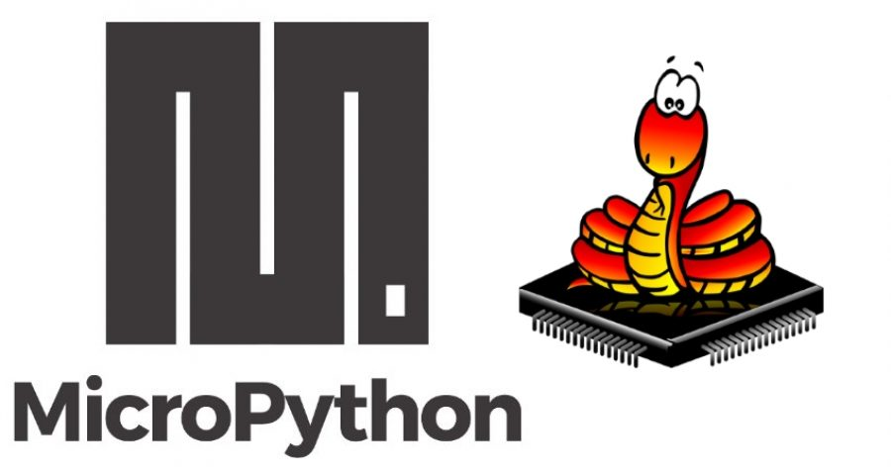
Background
Microcontrollers &
MicroPython

Slide 5
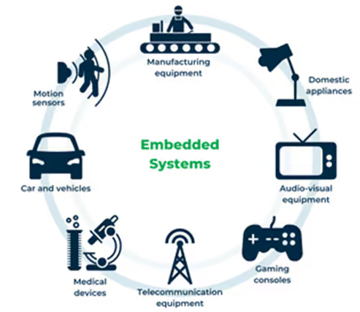
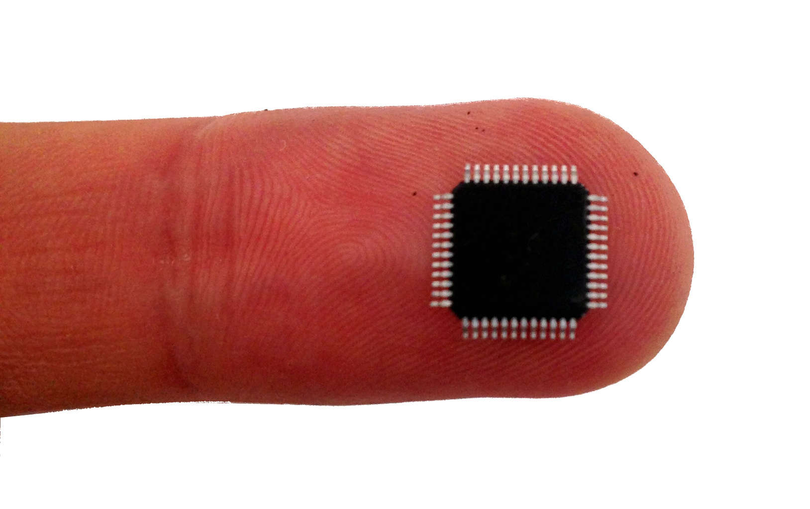
Microcontroller - tiny programmable chip
Compute power: 1 / 1000x of a smartphone
RAM: 0.10 - 1 000 kB
Program space: 1.0 - 10 000 kB
Compute 10 - 1 000 DMIPS
Price: 0.10 - 10 USD
Energy: 1 - 1 000 milliWatt
Efficiency is key ! Memory, compute, power
Over 20 billions shipped per year!
Increasingly accessible for hobbyists
2010: Arduino Uno 2014: MicroPython 2019: MicroPython 1.10 - ESP32 PSRAM
Notes:
Microcontroller is a small programmable chip.
That since the last 20 years provides the “brain” of basically any electronics device around us.
All the devices that you have in your home have 1 or more microcontrollers each.
A modern car has over 50 microcontrollers.
While they are mostly used for industrial application, they are increasingly accessible for hobbyists and semi-professionals. And today many of these devices can run Python! So in a way, you probably already know how to program them.

Slide 6
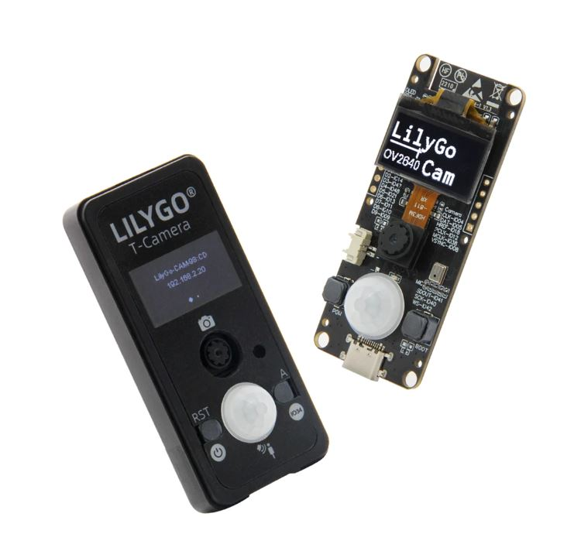
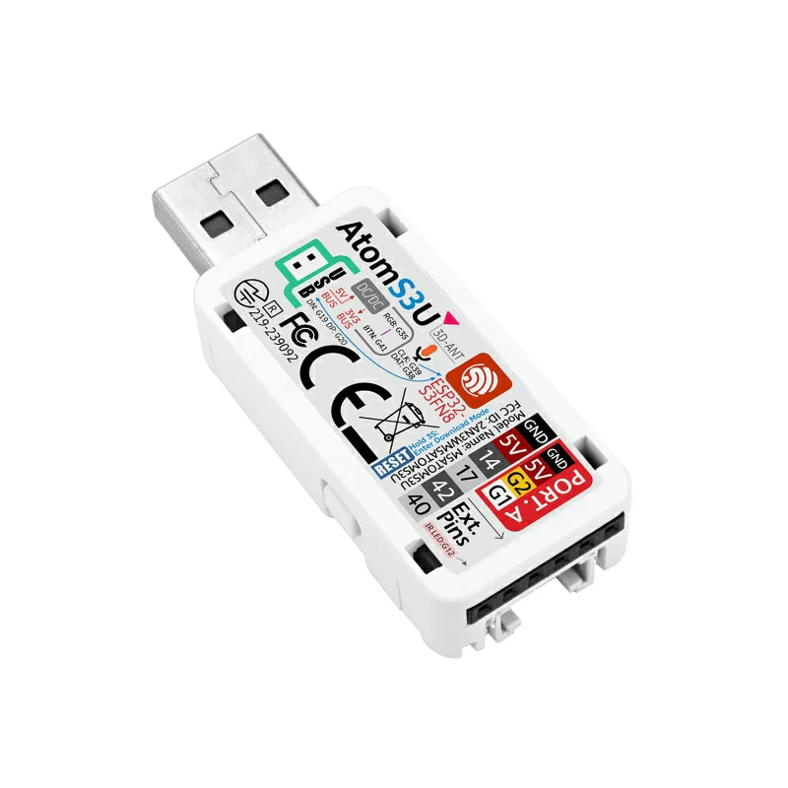
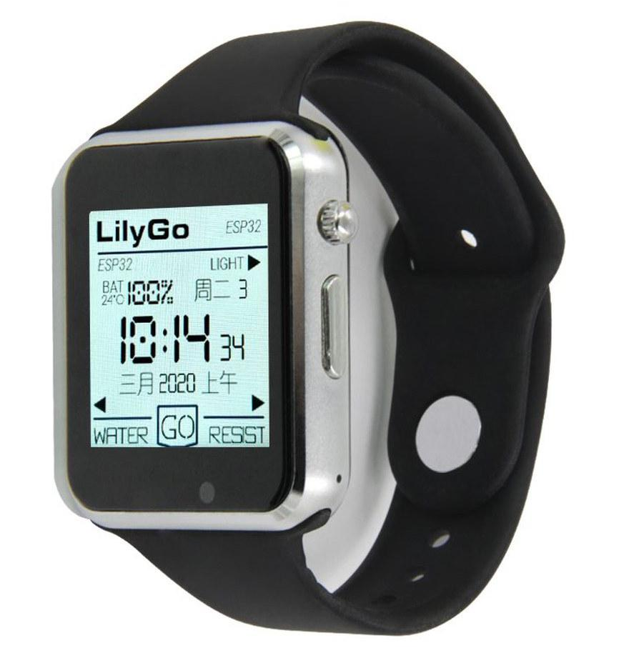
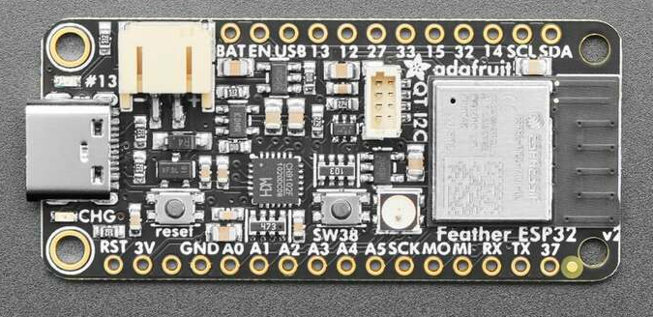
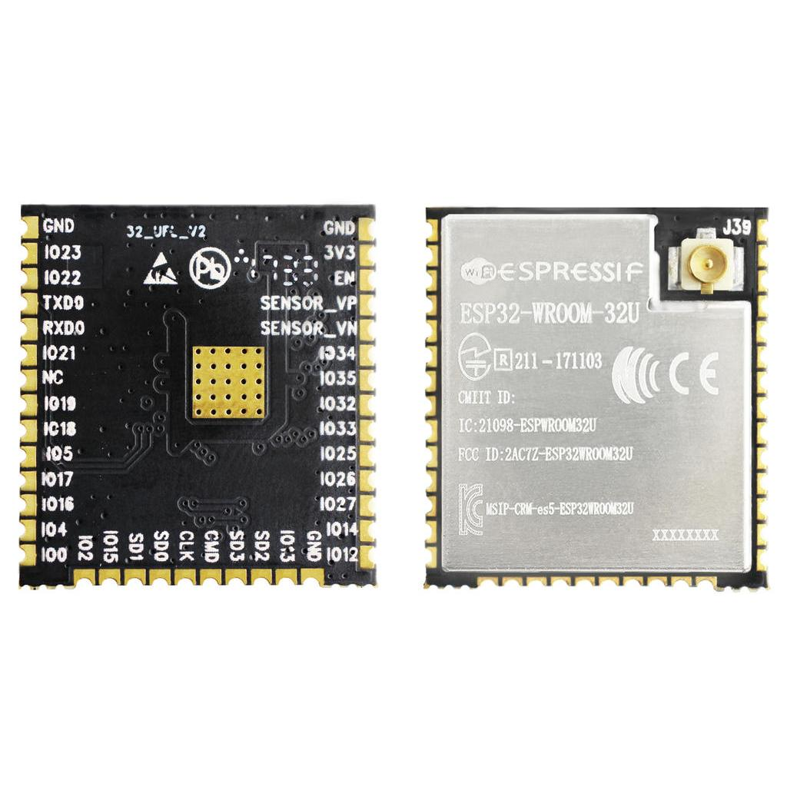
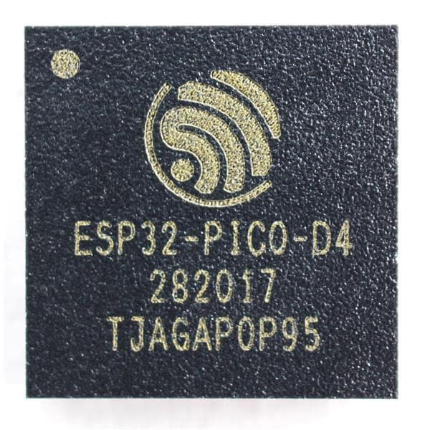
Hardware recommendation - start with a ESP32 device
Complete device with sensors etc.: 20 - 50 USD Development boards: 5 - 20 USD
Chips / modules 1 - 5 USD
Notes:
?

Slide 7
MicroPython introduction
Implements a subset of Python 3.x for devices with 16 kB+ RAM Supports 8+ microcontroller families
Tries to be as compatible with CPython as possible, within constraints.
Python 3.6 mostly implemented, partial after that.
No CFFI or C module compatibility! TLDR: Small scripts will mostly work with minor mods. But not PyData stack
Package manager “mip install” Has support for loading C modules at runtime!
More info: https://micropython.org

Slide 8
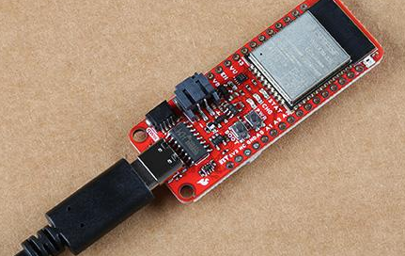
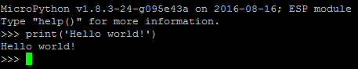
Installing MicroPython
Download prebuilt firmware https://micropython.org/download/?port=esp32
Flash firmware to device
pip install esptool
esptool.py --chip esp32 --port … erase_flash
esptool.py --chip esp32 --port … write_flash -z 0 micropython-v1.17.bin
Connect to device
pip install mpremote mpremote repl
IDE (optional): Thonny, VS Code, et.c.
Notes:
! drives for peripherals that are on a board not included in core firmware
Will likely need to hunt a bit for each sensor, screen etc

Slide 9
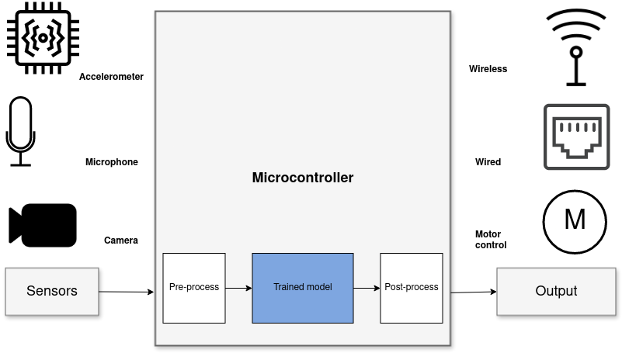
Sensor node systems
Including on-sensor data processing with Digital Signal Processing (DSP) and Machine Learning (ML)
“Internet of Things”
“Wearable devices”
Robotics, Industrial automation
Notes:
But one usecase where ML is incredibly useful is in analysing sensor data.
Sensors such as accelerometers, microphonones, radars, and cameras have gotten incredibly cheap and powerful.
But in order to get useful information out of these, the raw data must be processed.
Using Machine Learning, in combination with Digital Signal Processing, allows analyzing complex phenomena.
If this is done on the microcontroller, we get a range of benefits:
...
The component in blue is the Machine Learning model, and is typically trained ahead of time on a PC.

Slide 10
Sensor data processing
What can be done on an ESP32 microcontroller with MicroPython and how to make it work

Slide 11
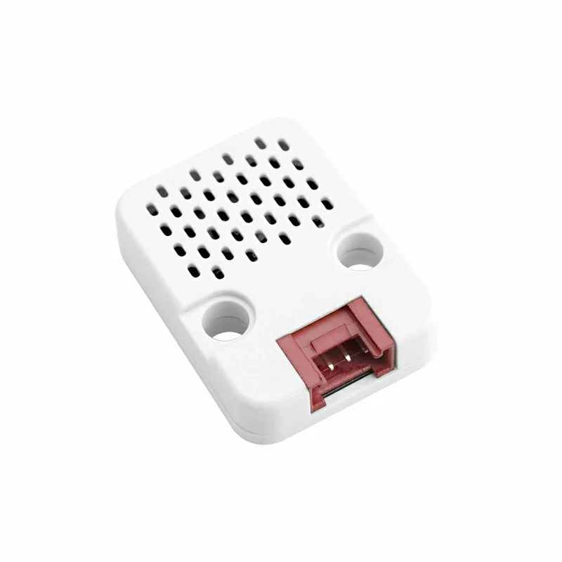
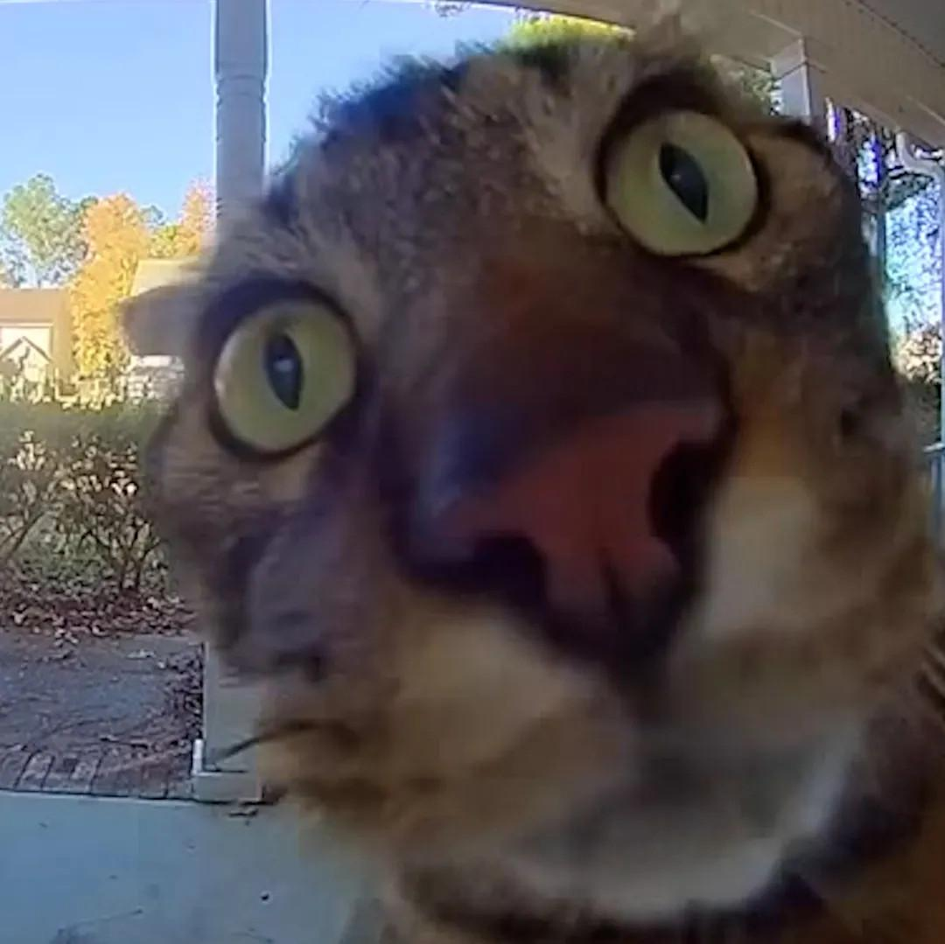
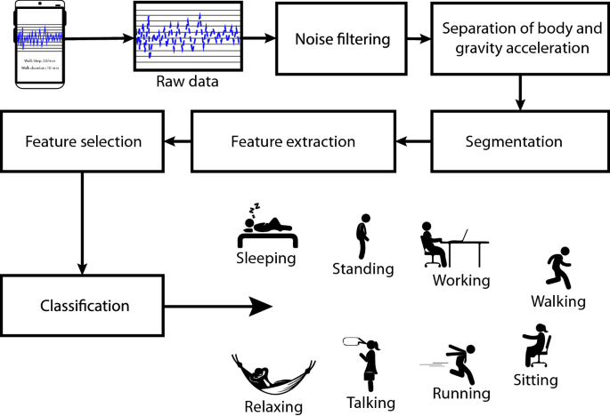
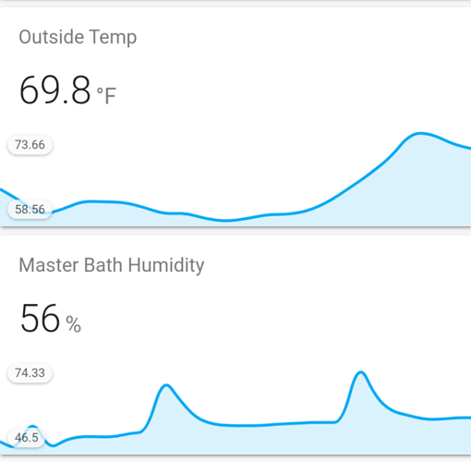
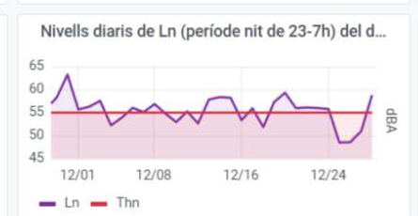
Temperature logger
Activity tracker
Noise monitor
Cat Detector
Temperature 0.1 Hz
Accelerometer 100 Hz
Microphone 16000 Hz
Camera 27000 bytes/s
if is_MyCat(img): open_door()

Slide 12
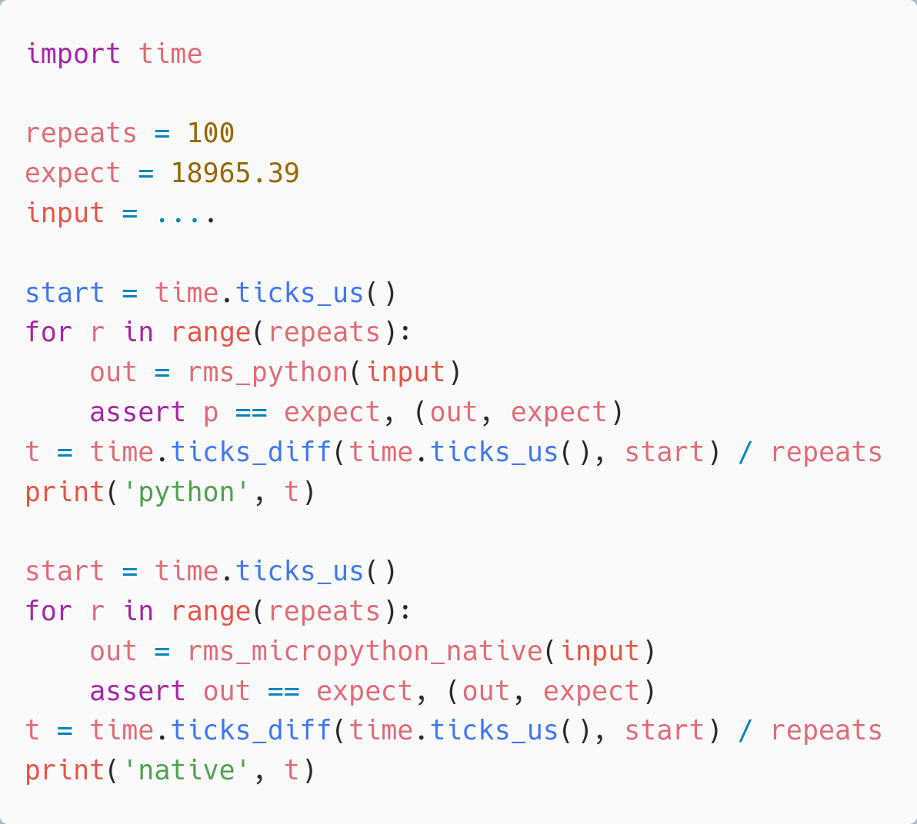
Make it Work, Make it Right, Make it Fast
– Ken Beck
Write simple automated tests, Code in straightforward Python, Measure performance with benchmarks
Optimize if needed Start with simple techniques
Go more advanced if needed
time.time and assert for benchmark and tests

Slide 13
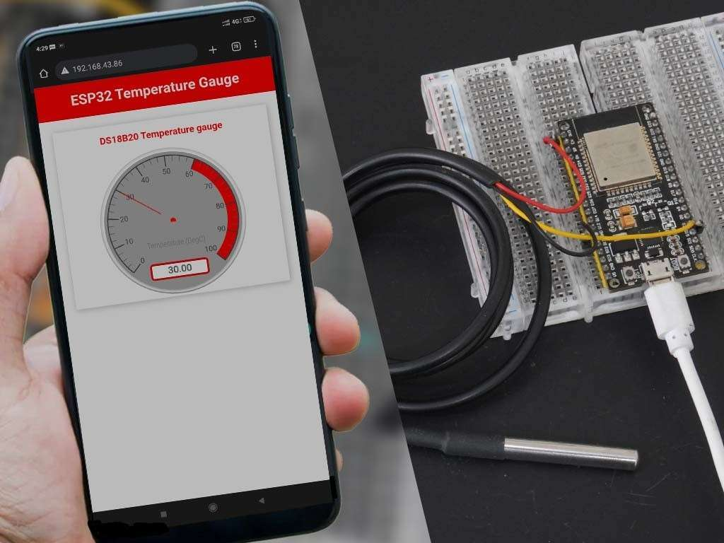
Temperature sensor
Temperature is a slow changing phenomena. Want: 1 value for longish time interval (ex: 5 min)
! Sensor can be noisy. Filtering advised
Will show analog sensor example. Same approach can be used for a digital sensor. And for other slow-changing phenomena.

Slide 14
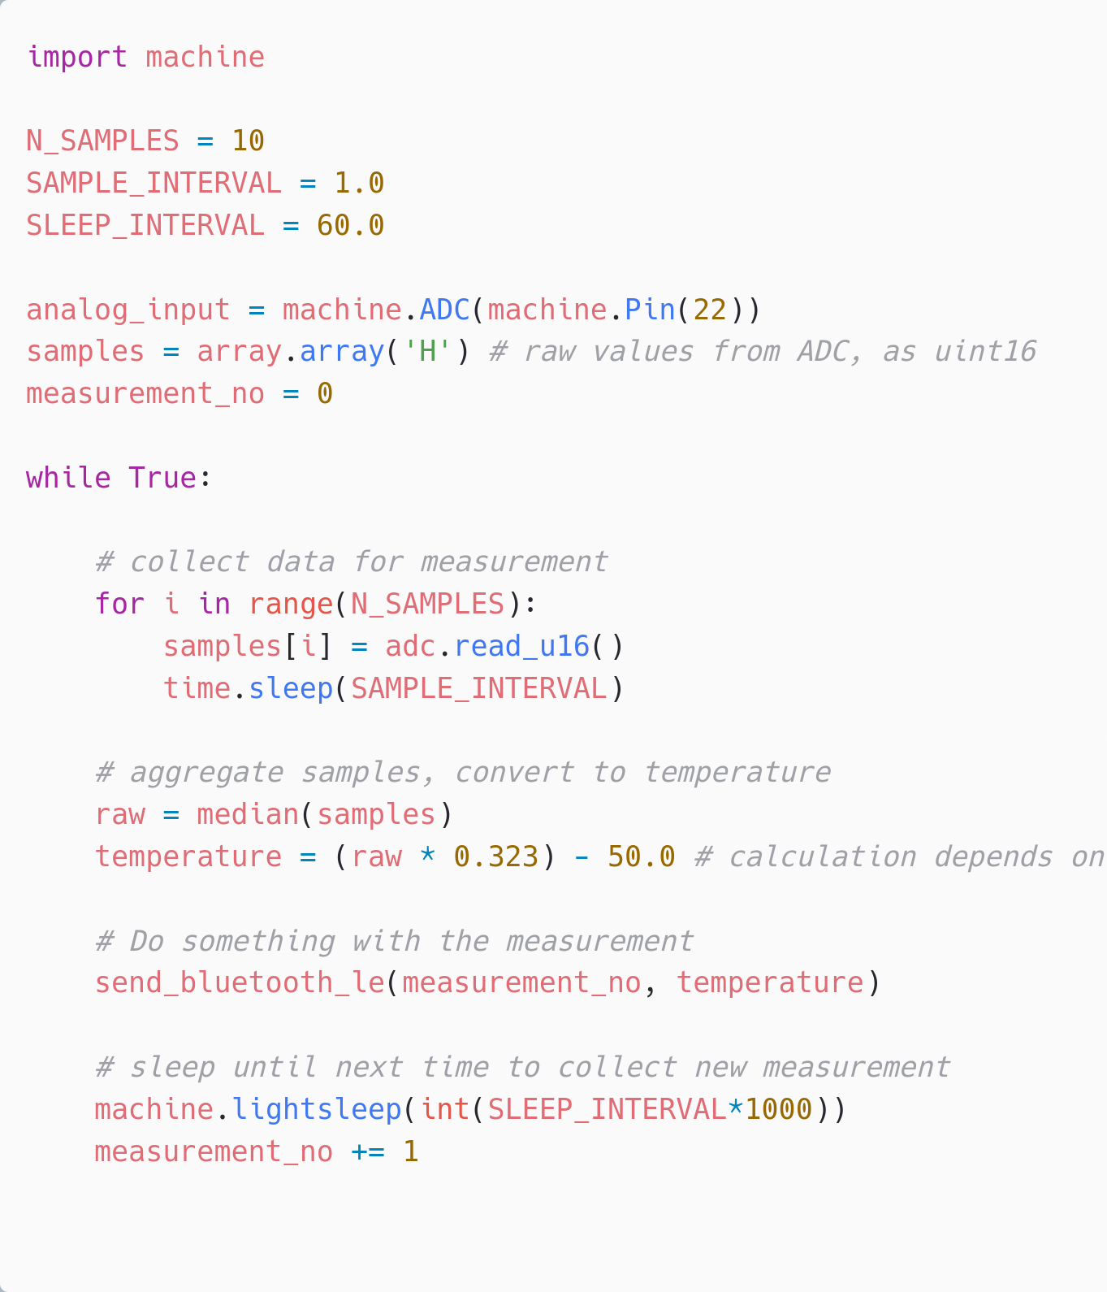
Temperature sensor
Solution: Read the sensor in a loop Filter noise using use a median filter.
= Trivially doable in straightforward Python
Efficiency techniques (non-critical)
Using lightsleep() to conserve power.
Pre-allocate fixed array.array, instead of over mutating a list (append) - to reduce allocations
Sending data as Bluetooth Low Energy advertisements, see
https://github.com/orgs/micropython/discussions/15926

Slide 15
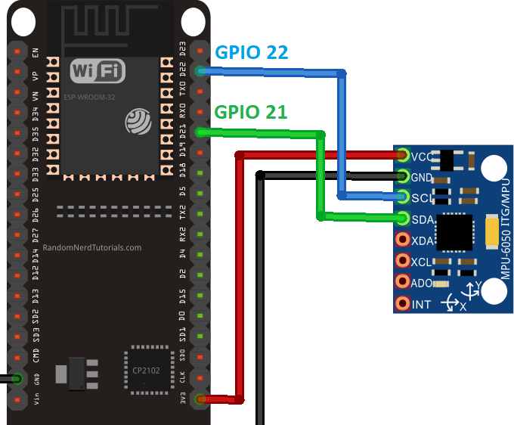
Activity tracker - concept
I2C MEMS IMU accelerometer/gyro (Example wiring)
Complete hardware unit LilyGo T-Watch S3

Slide 16
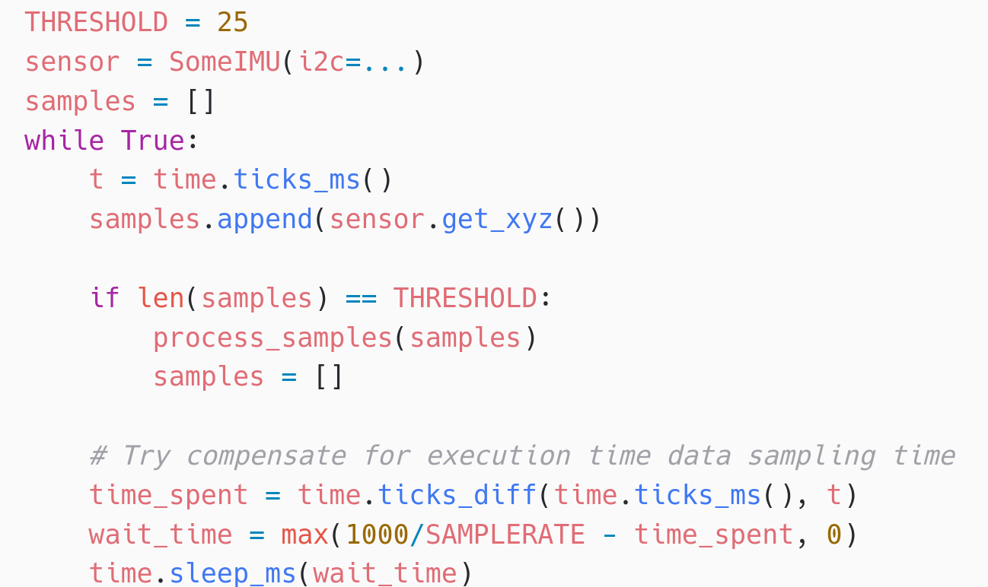
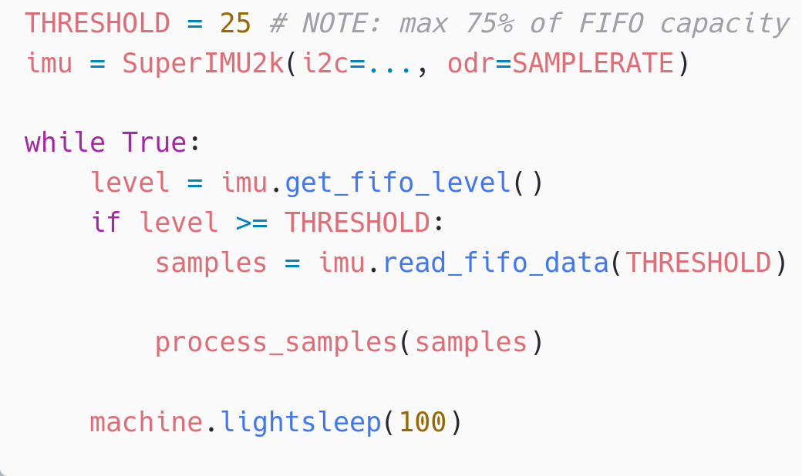
Activity Tracker - data acquisition
Polling individual samples
Must always use < 4 ms, otherwise will drop sample
Limits what process_samples() can do
! GC can easily take 10-100 ms
Want data chunks of 1 second.
25 Hz sample rate. 4 ms between samples OK for basic Human Activity Detection Might for some tasks want 100+ Hz. Efficiency techniques (recommended)
Utilizing FIFO buffer in sensor
Using lightsleep() to conserve power.
Using sensor FIFO buffer
Can spend 100 ms+ on processing
Can sleep 90%+ of the time
Perfectly spaced samples, always
Implementing an IMU/accelerometer/gyro driver? Use the FIFO!
https://github.com/orgs/micropython/discussions/15512

Slide 17
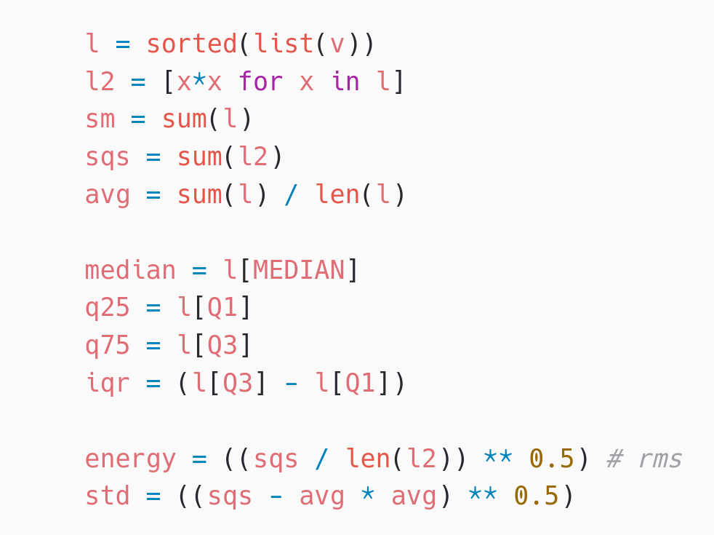
Activity Tracker - Feature Extraction
Basic statistical summarizations are useful. Can be sufficient for Human Activity Recognition
At 25 Hz, 3 channels, every 1 second. Doable in pure Python Estimated processing time 10-100 ms
Can be optimized using specialized code emitters. More later…
Time-based features extraction Are Microcontrollers Ready for Deep Learning-Based Human Activity Recognition?
Atis Elsts, and Ryan McConville
https://www.mdpi.com/2079-9292/10/21/2640

Slide 18
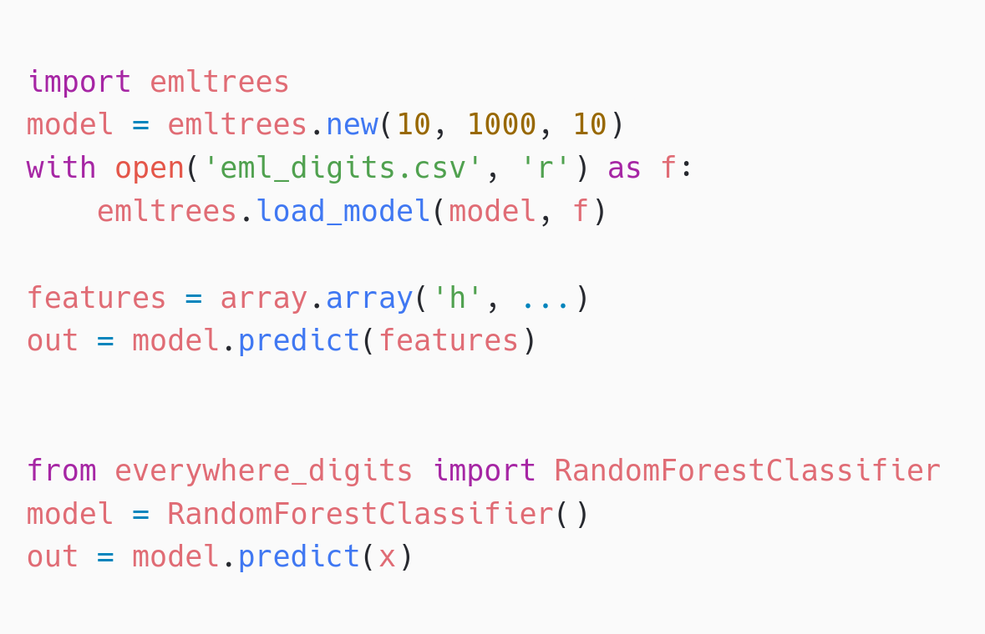
Activity Tracker
Classification using Random Forest
everywhereml / m2cgen: Generate Python .py code module emltrees from emlearn-micropython Dynamic native module .mpy Implemented in C Load model from .csv file
10 trees sufficient for OK performance on common HAR datasets (PAMAP2/UCI)
10 trees, max 100 leaf nodes, “digits” dataset
Inference time Program space
m2cgen 60.1 ms 179 kB everywhereml 17.7 ms 154 kB
emlearn 1.3 ms 15 kB
10x faster 10x more space efficient

Slide 19
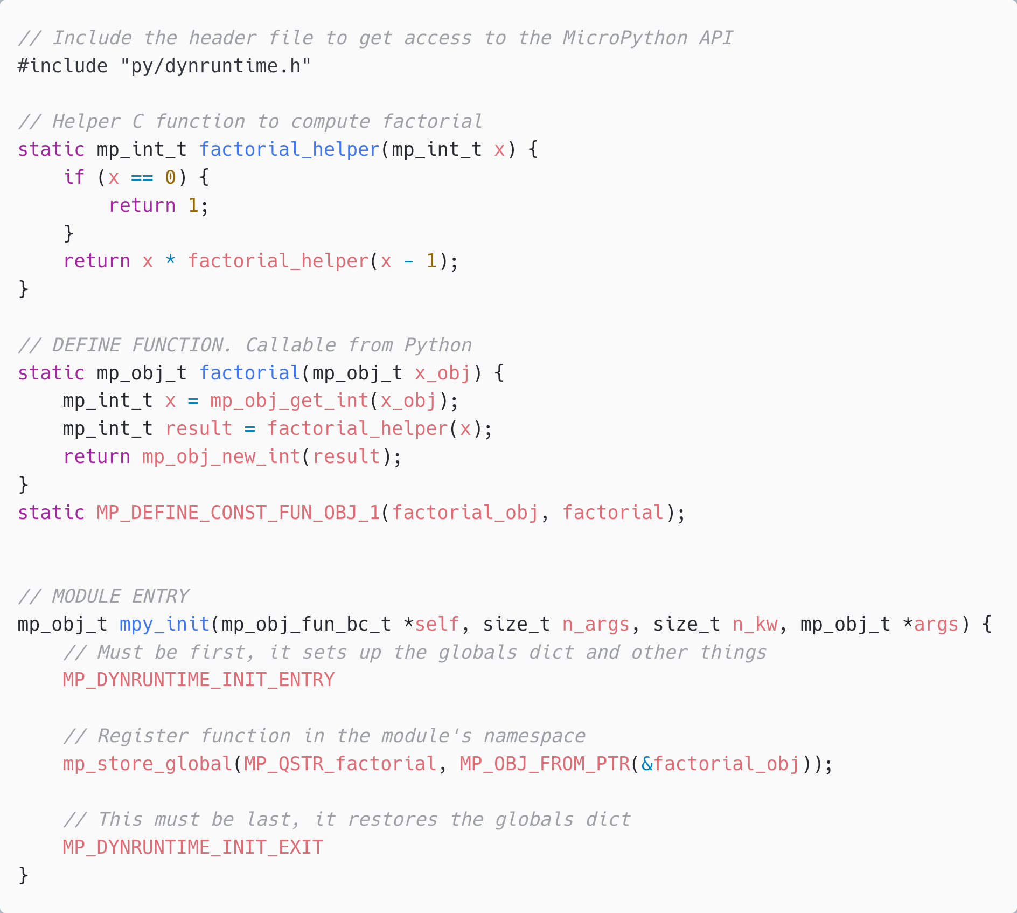
C modules
Written in C. Defines a Python module with API. functions/classes et.c.
Can be implemented by users, libraries or be part of MicroPython core.
Can be portable or specific to one hardware/platform

Slide 20
Native module (.mpy) VS External C module
 | Native module | External C module
Installable at runtime | Yes, as .mpy file | No. Must be included in firmware image
Requires SDK/toolchain | No (only to build) | Yes
Code executes from | RAM | FLASH
Limitations | No libc / libm linked * No static BSS * | None
Maturity | Low * | Excellent
Documentation | https://docs.micropython.org/ en/latest/develop/natmod.html | https://docs.micropython.org/ en/latest/develop/cmodules.html
* Improved greatly in upcoming MicroPython (1.24+). Contributions by Volodymyr Shymanskyy, Alessandro Gatti, Damien George, and others

Slide 21
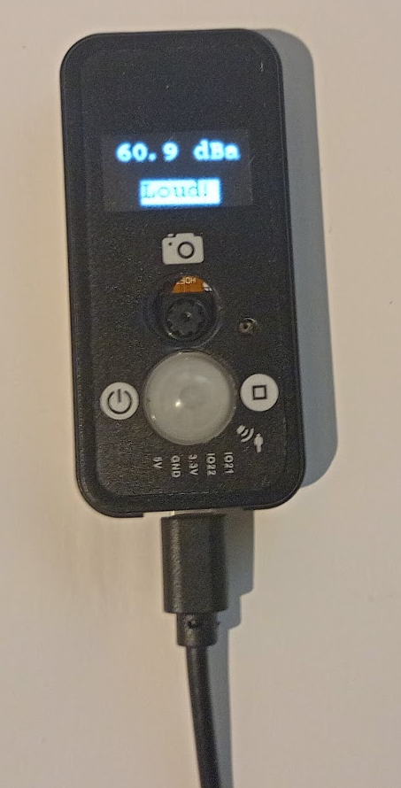
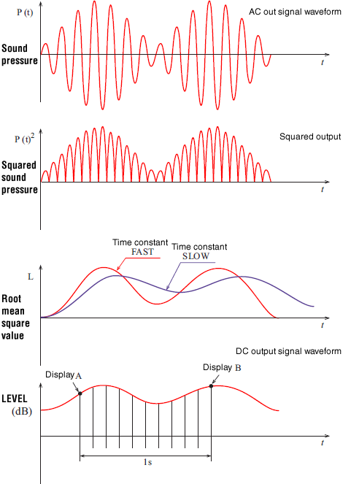
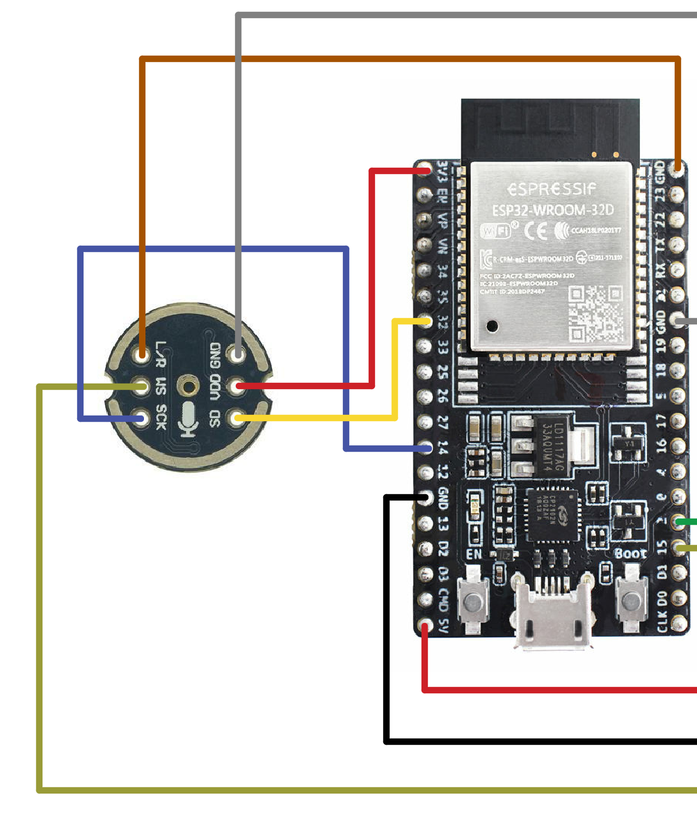
Sound sensor
Soundlevel calculation Processing steps
I2S digital microphone (Example wiring)
Complete hardware unit LilyGo TTGO T-Camera Mic v1.6

Slide 22
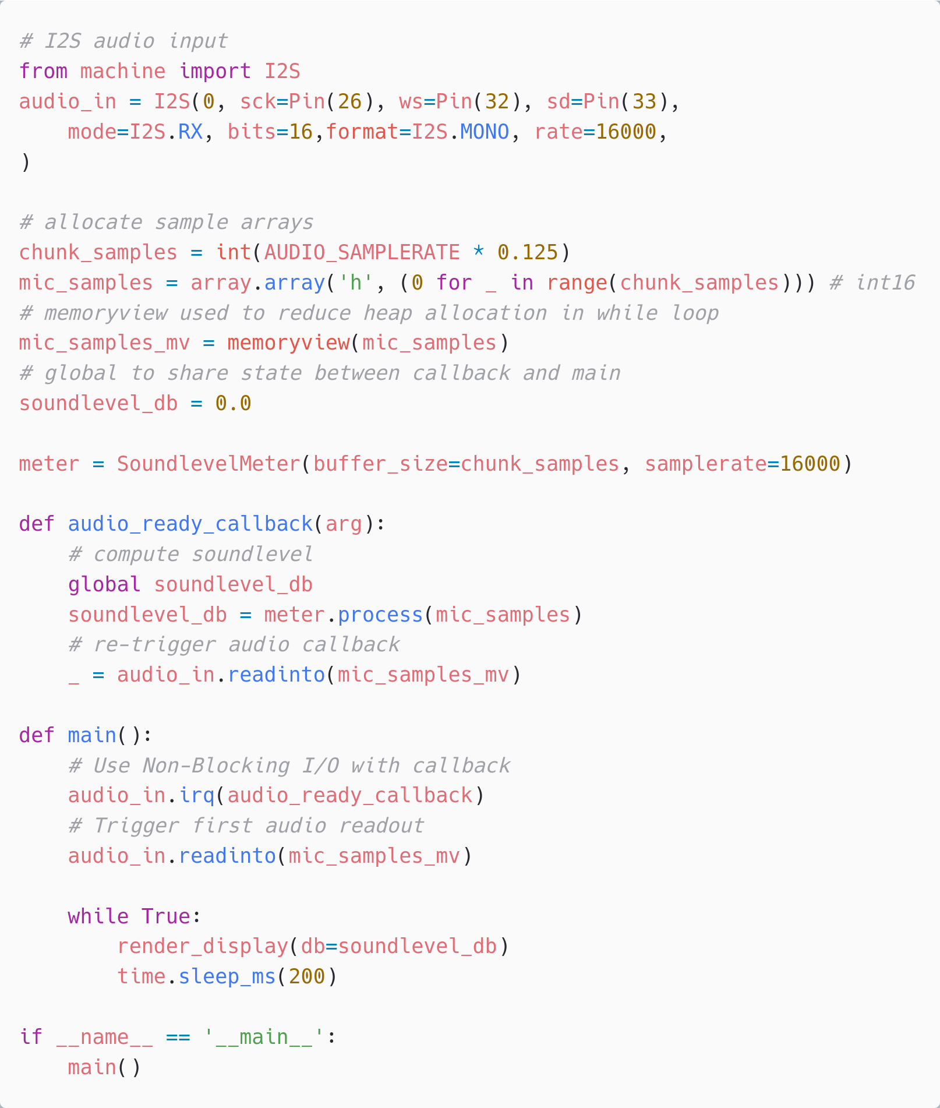
Sound sensor - Data Acquisition
16 kHz samplerate - no problem to read 48 kHz would probably also read fine - but 3x the load for processing.
Efficiency techniques (critical)
Using dedicated I2S hardware for audio input
memoryview() to allow bytes-based API to write into our int16 array, without needing conversion
Rendering text/widgets to screen
https://github.com/peterhinch/micropython-nano-gui

Slide 23
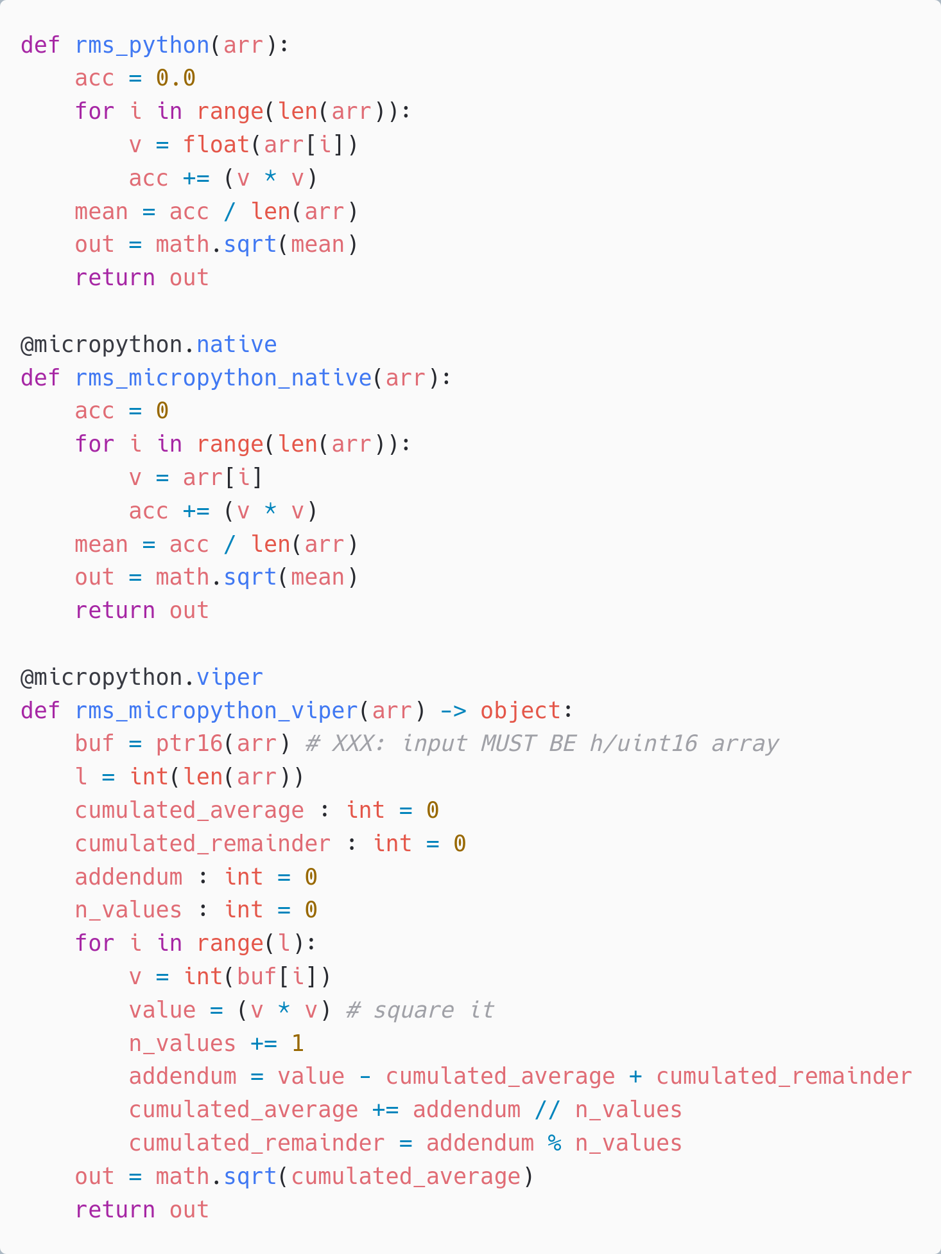
Sound sensor - RMS calculation
1. 113 ms 95% CPU
Plain Python
All floats
125ms @ 16kHz = 2000 samples Processing deadline: 125 ms Root Mean Square (energy calculation)
Plain Python = too slow!
Native emitter + trivial change = runs fine
Viper emitter + low-level rewrite for integer-based arithmetic = add 10x efficiency
2. 35 ms 28% CPU Native emitter
Integer squaring Float accumulator
3. 2 ms 2% CPU
Viper emitter Integer-based
Cumulative Moving Average[1]
1. CodeProject.com: Stefan Lang (2014) Precise and safe calculation method for the average of large integer arrays https://www.codeproject.com/Articles/807195/Precise-and-safe-calculation-method-for-the-averag

Slide 24
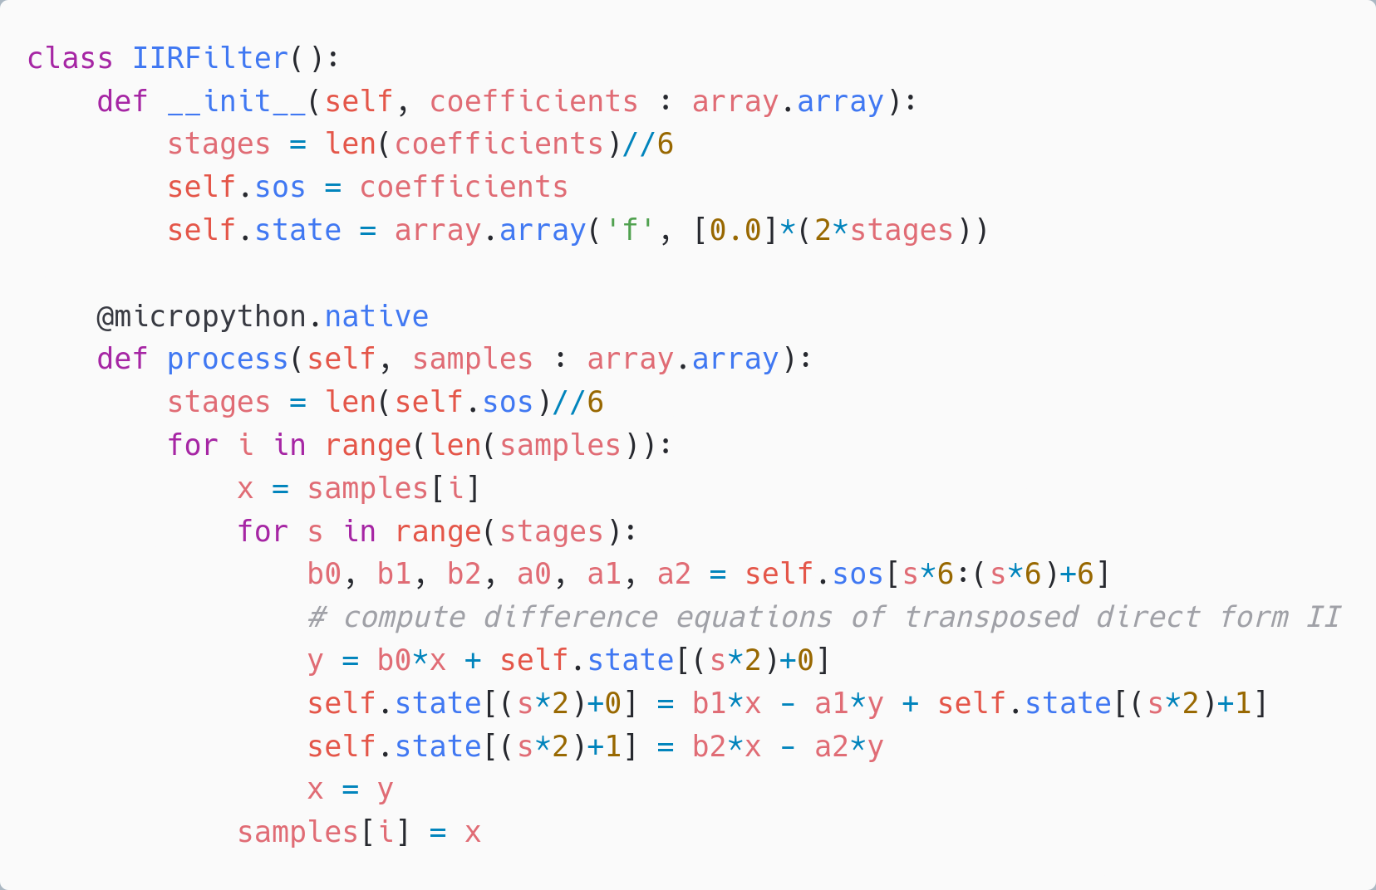
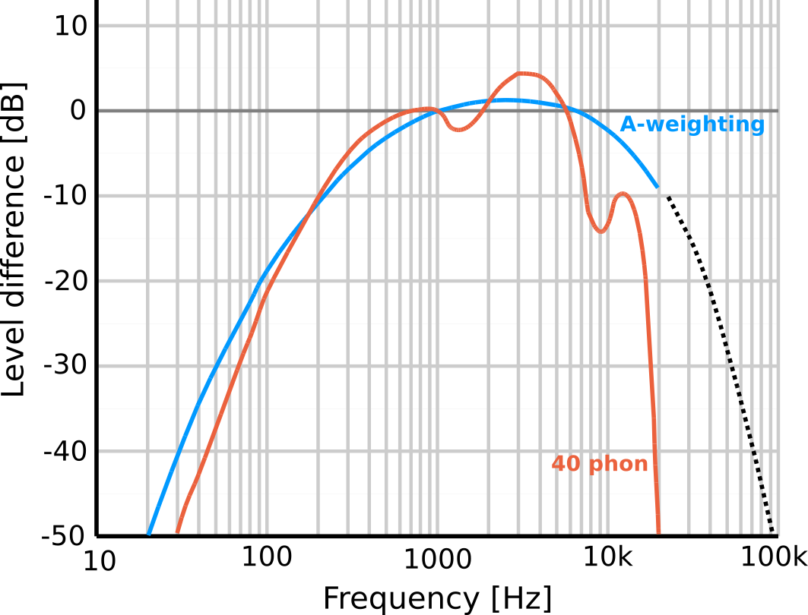
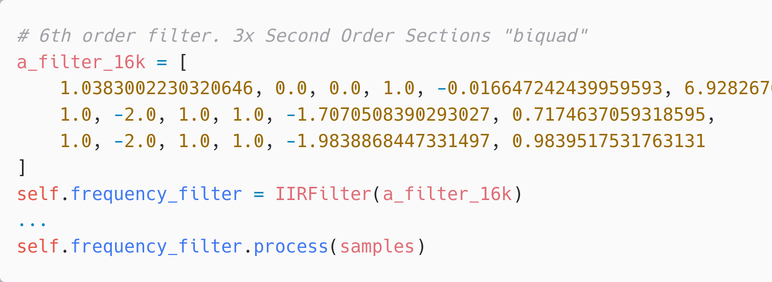
Sound sensor - IIR filter
1100 ms 900% CPU
Native emitter
Float
Too slow by ~10x
Standard sound level measurements are A-weighted. To approximate human hearing.
Typically, implemented using Infinite Impulse Response (IIR) filters.

Slide 25
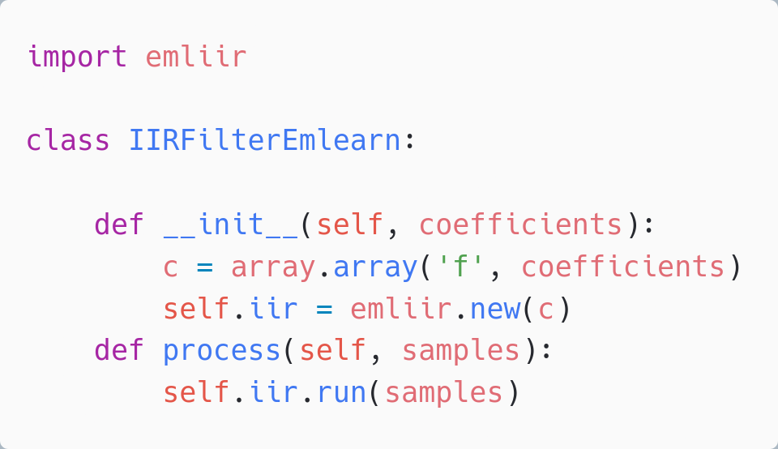
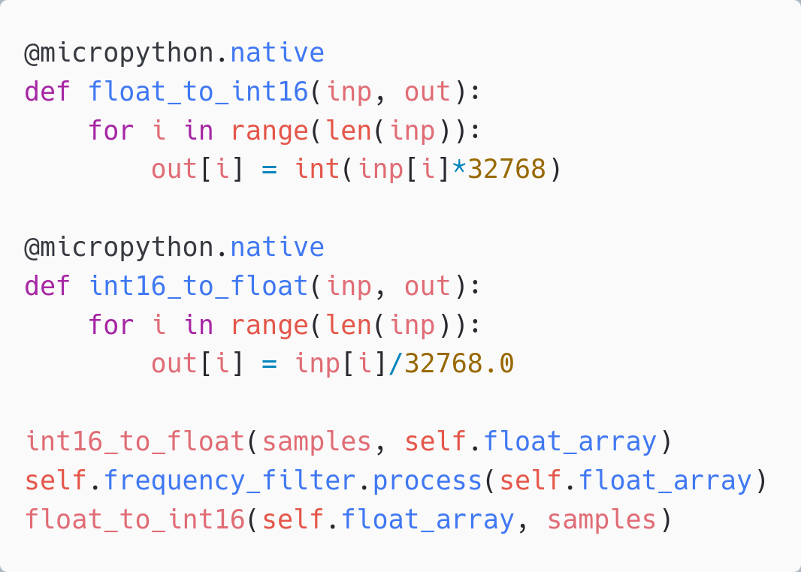
Sound sensor - IIR filter
IIR filter only Using emliir.mpy native module 30 ms 20% CPU - OK
Using emliir.mpy native module helps a lot.
BUT - conversion from float/int16 too slow Also needs a native module
But need to convert data types
Adds 70ms+ with micropython.native
Too slow! Total > 100 ms Must create native module
emliir.mpy from emlearm-micropython https://github.com/emlearn/emlearn-micropython/

Slide 26
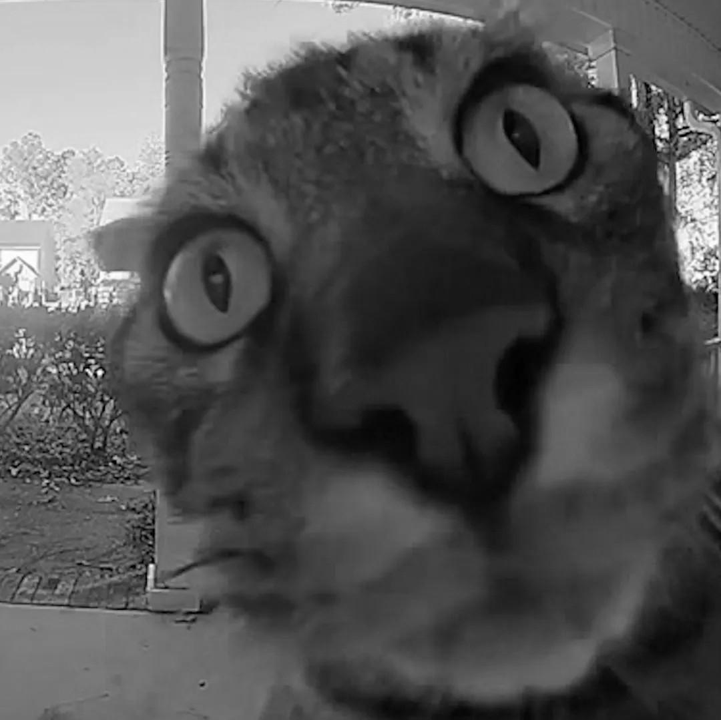
Cat Detector - Data Acquisition
Want: Classify low-res images, at 1 FPS+
Using mp_camera by cnadler86 https://github.com/ cnadler86/micropython-camera-API 96x96 px grayscale.
Takes ~100 ms - OK

Slide 27
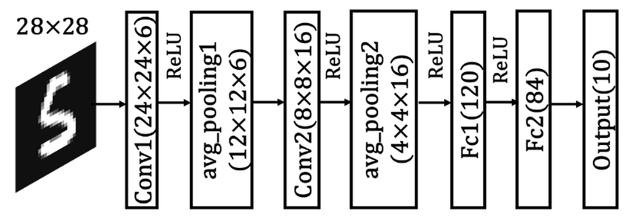
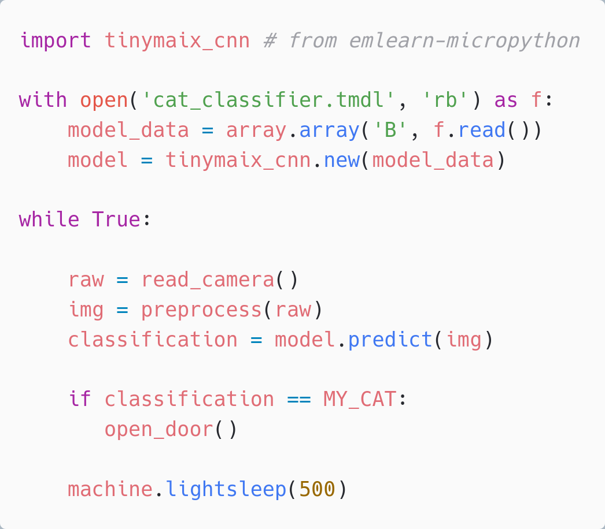
Cat Detector - Classification with CNN
Go-to solution for image classification:
Convolutional Neural Network (CNN)
tinymaix_cnn from emlearn-micropython 32x32 px input. 3 layers. Under 100 ms - OK
Preprocessing (untested) Downscaling 96 px -> 32 px
Image brightness normalization
= Image classification is doable (with native C modules) See also OpenMV - MicroPython for Computer Vision- https://docs.openmv.io/index.html
https://github.com/emlearn/emlearn-micropython/ tree/master/examples/mnist_cnn

Slide 28
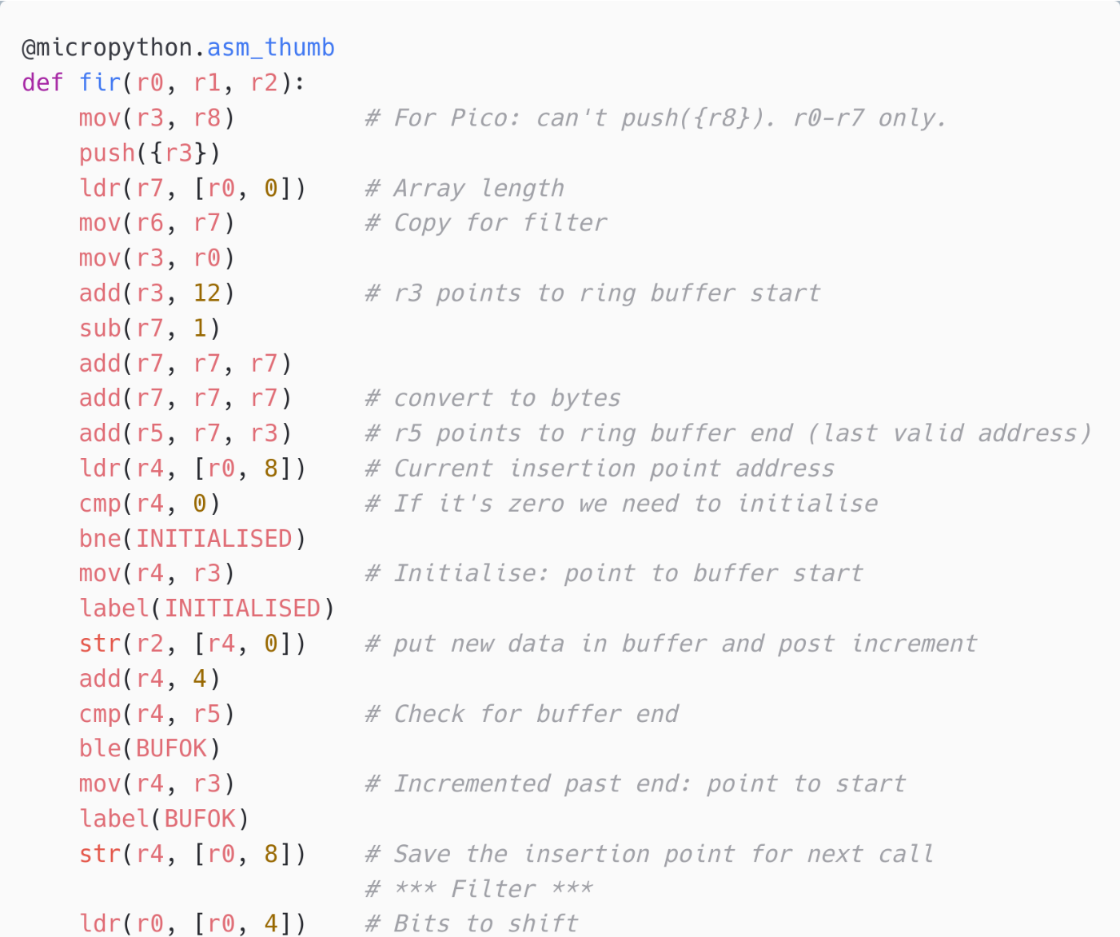
Inline Assembly
MicroPython can expose Assembler opcodes as Python statements.
Allows to write a function in Assembler inline in the Python program Can compile and execute on device
Supported on ARM Cortex M chips Not supported (yet) on ESP32
For the most hardcore hackers!
Official Documentation: https://docs.micropython.org/en/latest/ reference/asm_thumb2_index.html
Example: FIR filter implementation (cut out) https://github.com/peterhinch/micropython-filters/ blob/master/fir.py

Slide 29
Conclusions

Slide 30
Feasibility and techniques for sensor data processing
Accelerometer data et.c
Up to 1000 samples/second = doable with plain Python + Benefits from @micropython.native / viper
Sound and low-res/low-rate video Over 10’000 samples/second = use of C modules becomes key

Slide 31
Other resources
MicroPython docs: Maximising MicroPython speed https://docs.micropython.org/en/latest/reference/speed_python.html
PyConAU 2018: Writing fast and efficient MicroPython (Damien George) https://www.youtube.com/watch?v=hHec4qL00x0
PyConAU 2019: Extending MicroPython: Using C for good!" (Matt Trentini) https://www.youtube.com/watch?v=437CZBnK8vI
MicroPython docs: Extending MicroPython in C https://docs.micropython.org/en/latest/develop/extendingmicropython.html
PyCon Berlin 2024: Machine Learning on microcontrollers using MicroPython and emlearn https://www.youtube.com/@PyDataTV
Notes:
Microcontroller is a small programmable chip.
That since the last 20 years provides the “brain” of basically any electronics device around us.
All the devices that you have in your home have 1 or more microcontrollers each.
A modern car has over 50 microcontrollers.
While they are mostly used for industrial application, they are increasingly accessible for hobbyists and semi-professionals. And today many of these devices can run Python! So in a way, you probably already know how to program them.

Slide 32
Summary
1. Current microcontrollers can run Python thanks to MicroPython
2. MicroPython is a powerful platform for building sensor nodes
3. Wide range of performance tools available for creating advanced and efficient sensor nodes
4. emlearn-micropython is a collection of native modules for Machine Learning in MicroPython
Learn more: https://github.com/ emlearn/emlearn-micropython

Slide 33
Sensor data processing on microcontrollers
with MicroPython and emlearn https://github.com/emlearn/emlearn-micropython
Jon Nordby jononor@gmail.com
PyCon ZA 2024
Notes:
Hi everyone. Glad to see so many being curious about microcontrollers! I have with be a munch of MicroPython compatible devices today. So if anyone is interested in borrowing for trying it out, we can do that after the session. On the A floor, next to the tutorial rooms. And one lucky person that asks a question will get one of these devices to take home!

Slide 34
Bonus

Slide 35
TinyML for MicroPython - comparisons
Project | Deployment | Models | Size | Compute time
emlearn -micropython | Easy. Native mod .mpy | DT, RF, KNN, CNN | Good | Good
everywhereml | Easy. Pure Python .py | DT, RF, SVM, KNN, | High with large models | Poor
m2cgen | Easy. Pure Python .py | DT, RF, SVM, KNN, MLP | High with large models | Poor
OpenMV.tf | Hard. Custom Fork | CNN | High initial size | Good
ulab | Hard. User C module | (build-your-own) Using ndarray primitives | High initial size | Unknown (assume good)
Notes:
Benchmark vs other MicroPython approaches

